Slide 1
[ Gate Review #3 (’21.5.28 Fri 10:00~11:0) ]
Attendants
Kim Choonghan Yoon Byunjun
Park Chanho Kim Chiwon
Progress Achievements (5.21 ~ 5.28)
Future Plan (5.28 ~ 6.1)
-Comparing Base Models
7. B5 Image add
8. B5 cutoff Aug(Aug Train data)
9. B5 RA Aug(Aug Train data)
10. B5 AA Aug(Aug Train data)
11. B5 cutoff Aug(Train + aug data)
12. B5 RA Aug(Train + aug data)
13. B5 AA Aug(Train + aug data)
16. ViT-B/16 Image add
17. ViT-B/16 cutoff Aug(Aug Train data)
18. ViT-B/16 RA Aug(Aug Train data)
19. ViT-B/16 AA Aug(Aug Train data)
20. ViT-B/16 cutoff Aug(Train + aug data)
21. ViT-B/16 RA Aug(Train + aug data)
22. ViT-B/16 AA Aug(Train + aug data)
+ B5 without pretrained
+Vit-B16 without pretrained
-Study the key idea of architectures
Effinet, Vit, CAR
-Still 1st ranking in Kaggle
-Model Concatenation
Vit models. Top1 boosting. allocate different weights(Vit L16, V2, DEIT)
-Finishing comparing Base Models
-Study the key idea of architectures
Effinet, Vit, CAR
-Making presentation slide and highlight slide
-Pipeline for Final architecture,
-Clarify ourdataset ( Imagenet dataset augmented)
Issue Discussion
-When we use CAR data in the final model, the performance is downgraded
-Plot a CSV data using EXCEL program
-Next meeting will be on Tuesday 6 PM with dinner

Slide 2
# Attachments
Plan of Model Making
ResNet Base model
EffNet Model
b0 Model
b3 Model
b5 Model
ViT-B/16 Model
BICUBIC
BICUBIC
Super Resolution
Super Resolution
CAR
CAR
Augmentation
Augmentation
Aug train data
Train + aug data
Aug train data
Train + aug data
Cutoff
Cutoff
Cutoff
Cutoff
RA
RA
RA
RA
AA
AA
AA
AA
b7 Model + Fine Tuning Hyperparameters

Slide 3
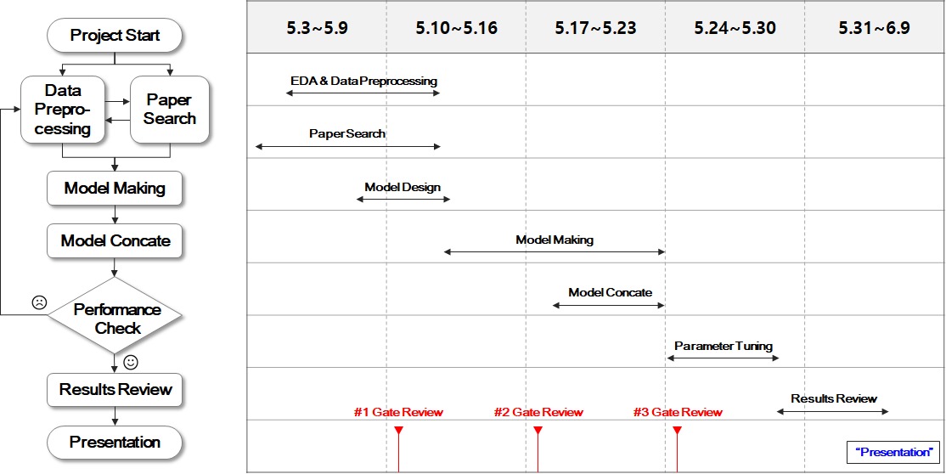
# Attachments

